Slide 1
Smart Home not People
Project made by: Alessandro Cacciabue, Daniele Obrelli, Cosimo Tobia Zaffino

Slide 2
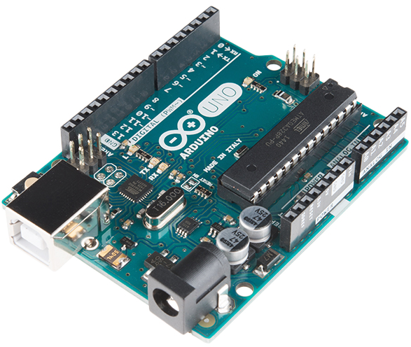
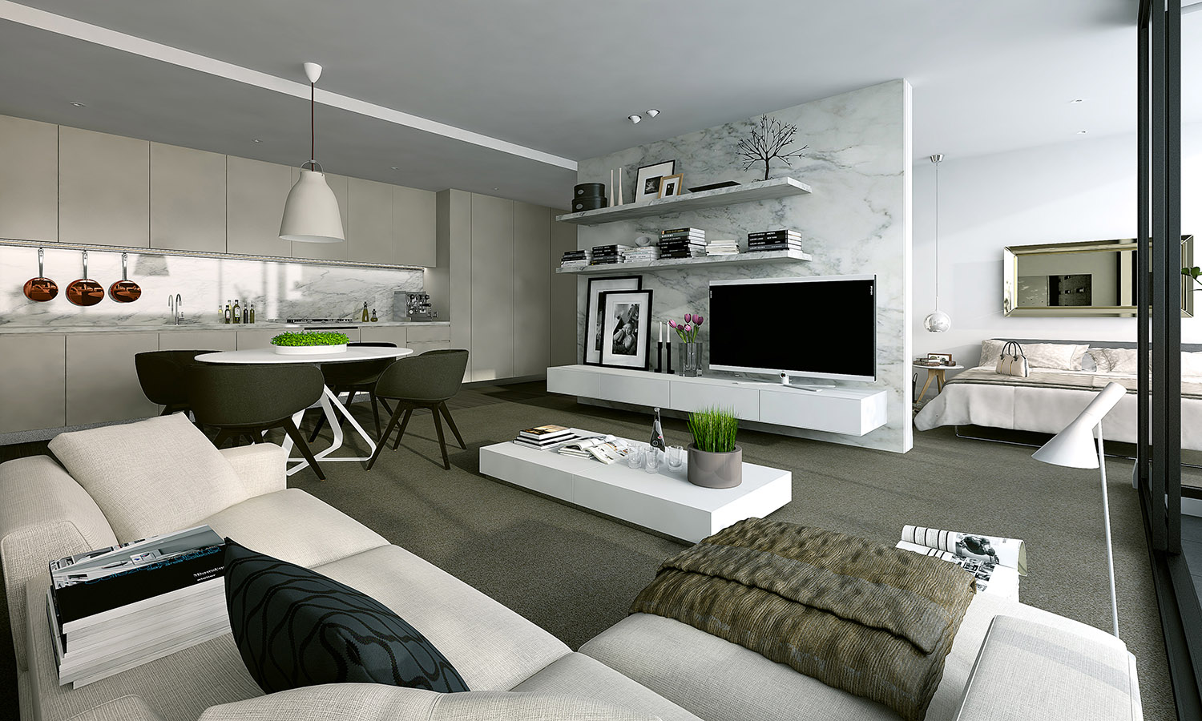

Improve our home
Our system is designed to handle some aspects of our daily life in our home and hopefully improve them.

Slide 3
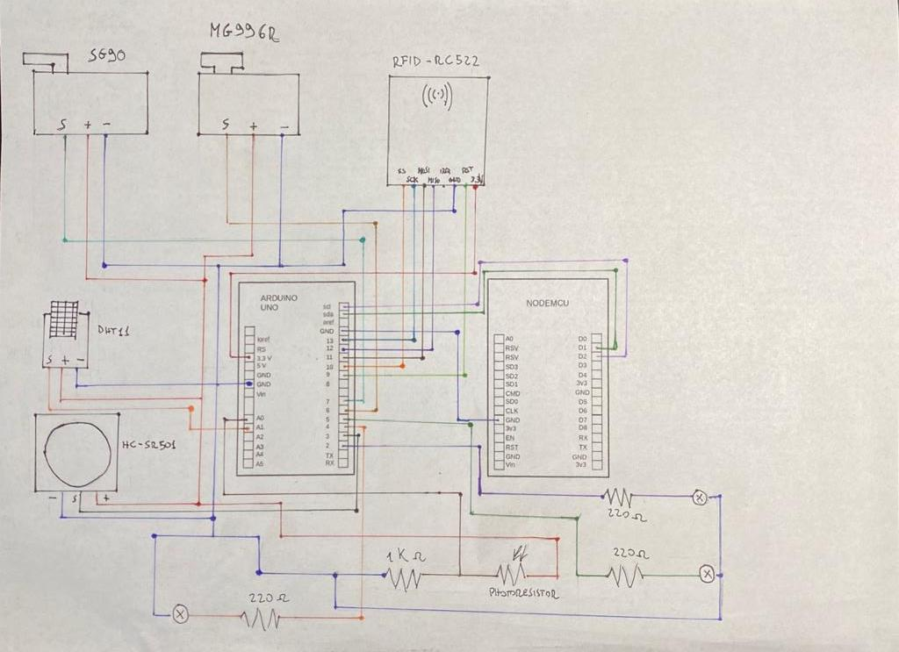
Basic Working Scheme
Different interactions with our home functionality thanks to different sensors.

Slide 4
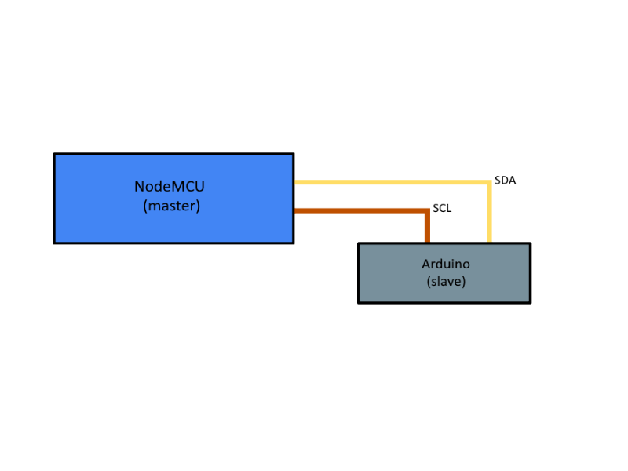
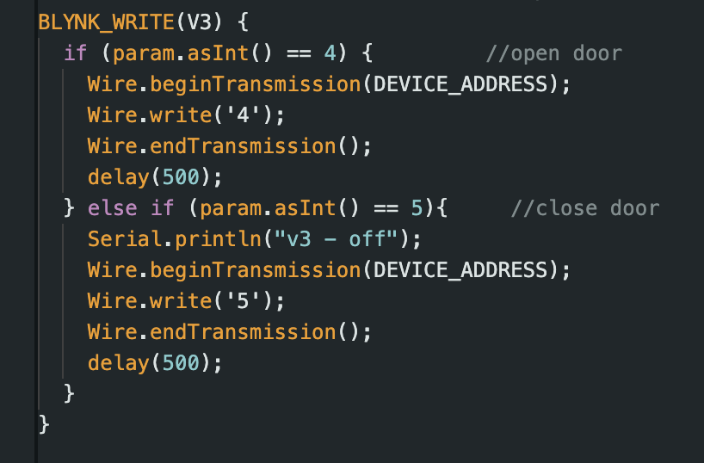
Software Architecture
In our system we use a I2C communication between the two microcontroller that we are using: Arduino and NodeMCU.
NodeMCU.ino
I2C scheme example
Example of communication with I2C from NodeMCU to Arduino

Slide 5
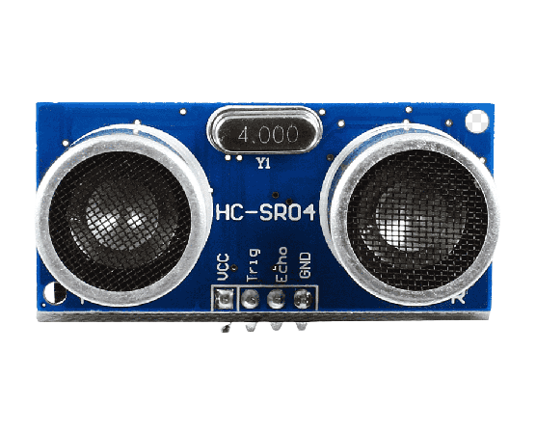
Debug and Testing
During the creation of our project we encountered various problem, big and small; so we had to debug along the project making.
Also, after every milestone that we achieved, like the correct configuration of a sensor, we would proceed to test the software.
One of the problem we encountered was with the Ultrasonic Sensor, HC-SR04.
We realised that it was receiving random noises caused by the small size of the box where we built our system. These noises activated the sensor even if it didn’t have to.

Slide 6

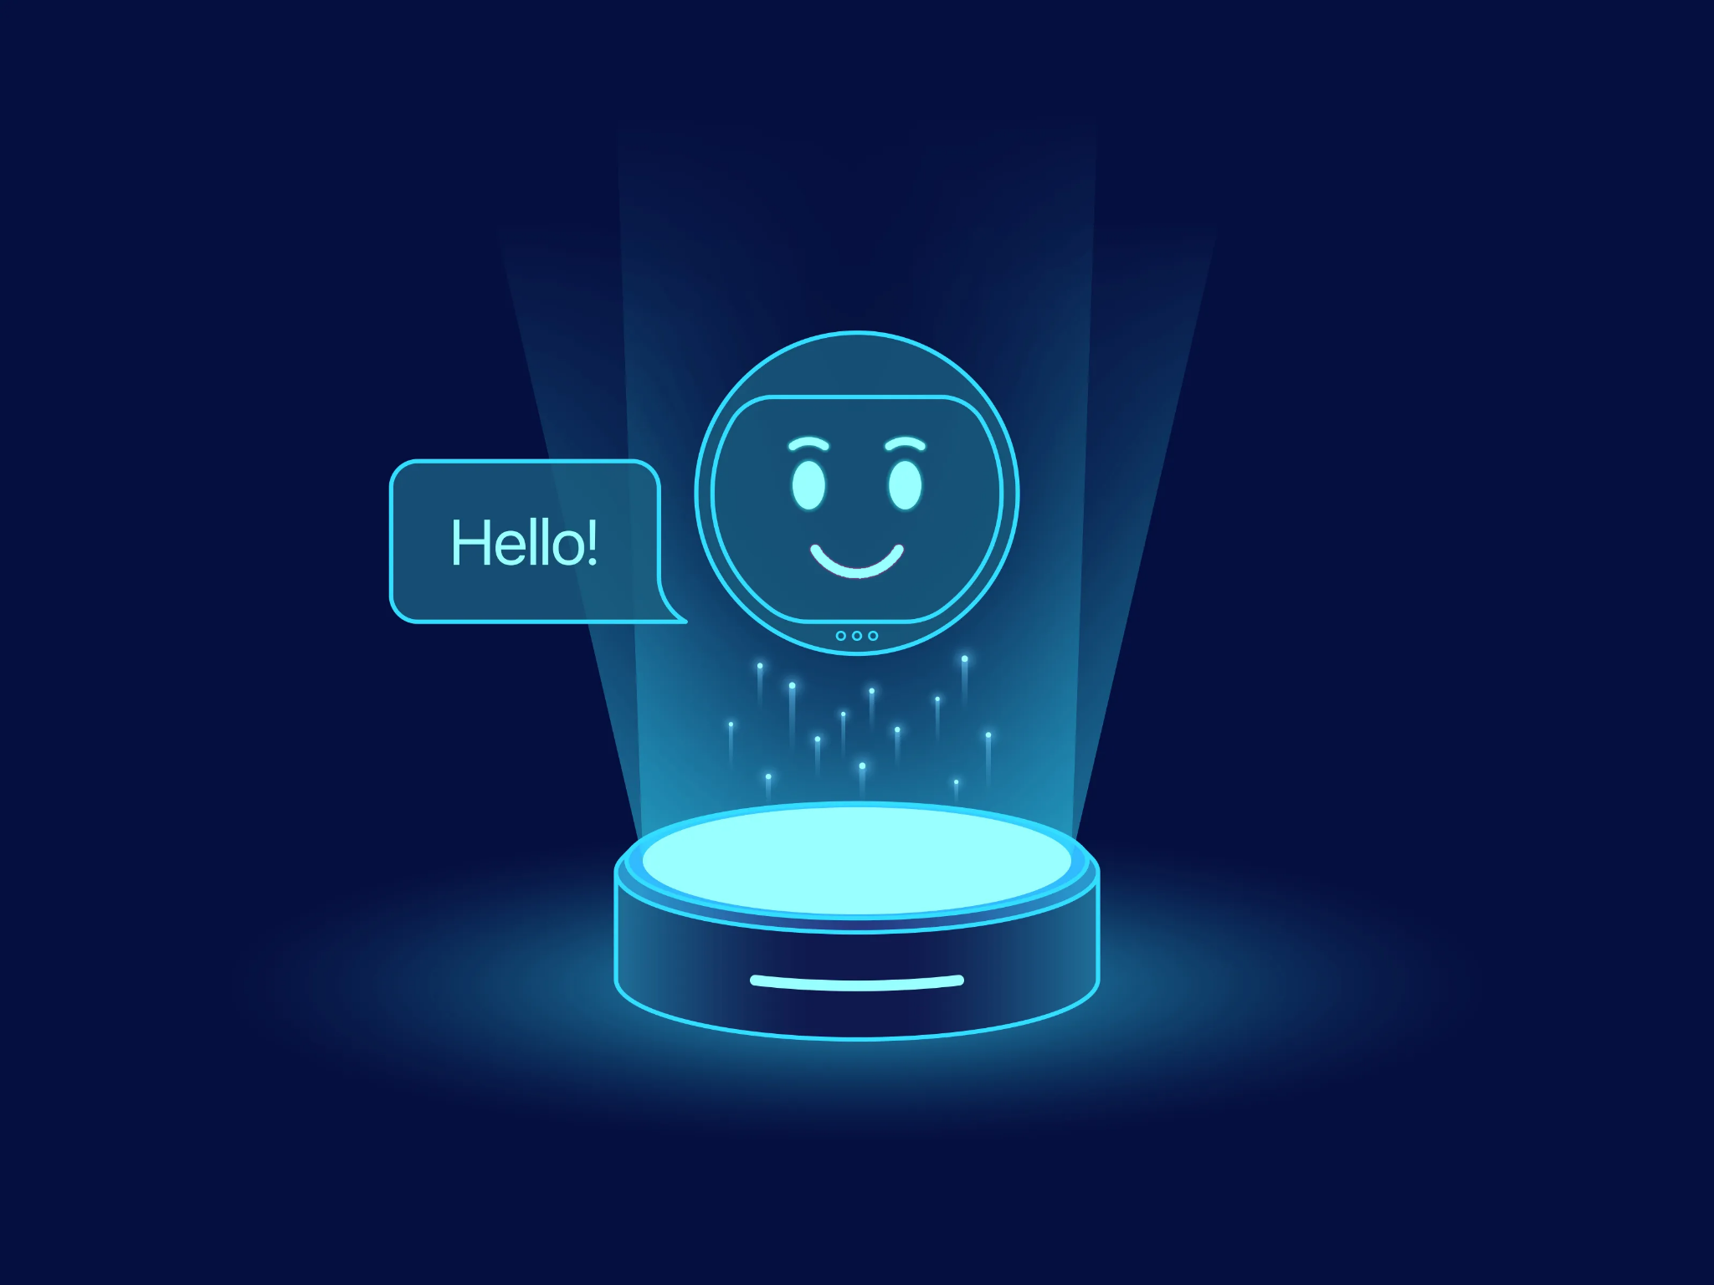
Is That All?
We can clearly say that our project is still in its early stages and sure there are some aspects that we can improve and also some features we can add.
The most important aspect to upgrade is the security of our project.
Sure we can add new feature to our system: one of the main functionality we can add is a vocal assistant or a voice recognizer to give commands and interact with our home more easily.

